Slide 1
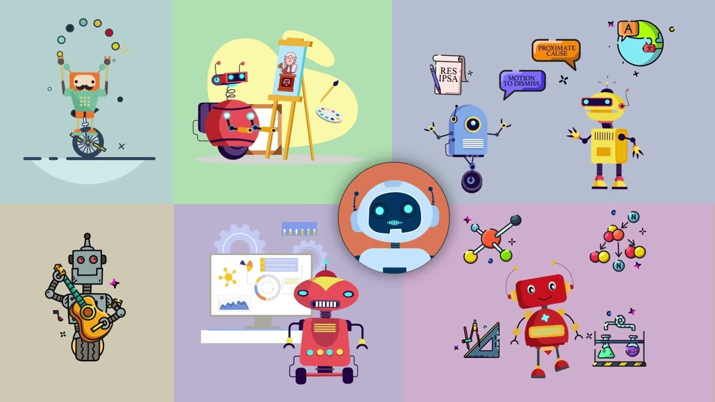

Building Artificial Intelligence Tools in the Legal Sector
AI Studio Final Presentation
LegalDuel
December 5, 2024
Notes:
Zoe slides 1-5

Slide 2

Introductions

Slide 3



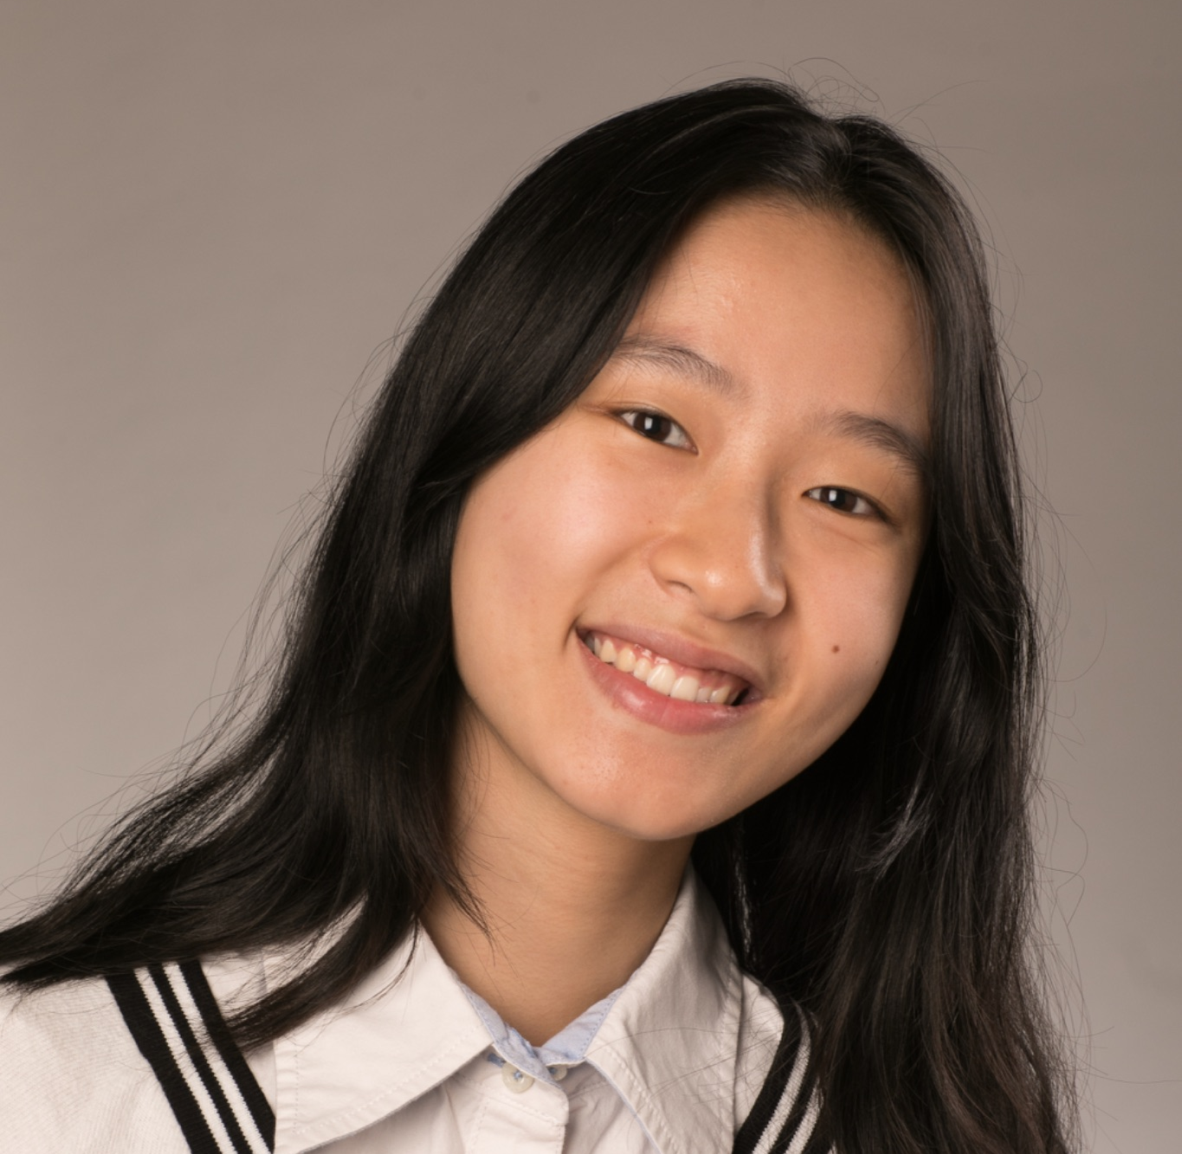
Meet Our Team
Zoe Bailey West Virginia University
Yomna Elmousalami Old Dominion University
Tiffany Fu Columbia University

Slide 4

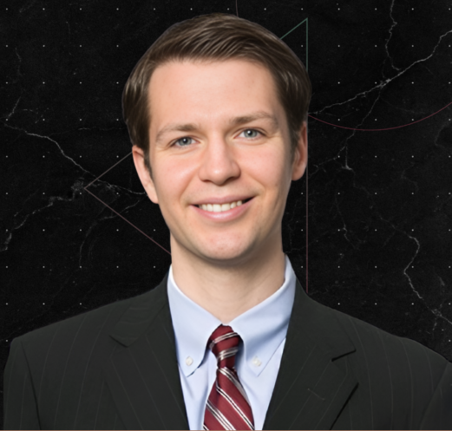


Our AI Studio TA and Challenge Advisors
<insert jpg>
<insert jpg>
<insert jpg>
Nandini Proothi AI Studio TA
Thor Alden Challenge Advisor
Anthony Puppo
Challenge Advisor
Kate McGuigan
Challenge Advisor
Notes:
nan-da-knee

Slide 5
Presentation Agenda
AI Studio Project Overview
Data Understanding
Modeling & Evaluation
Final Thoughts
Demo
Questions

Slide 6
AI Studio Project Overview
Notes:
Zoe will transition Yomna slides 7-10

Slide 7
“
Participants will develop AI-driven solutions for common legal tasks, including content generation, sentiment detection, and redaction.
Notes:
Yomna: The goal of our project was to develop AI-driven solutions for common legal tasks (content generation, sentiment detection, and redaction)

Slide 8
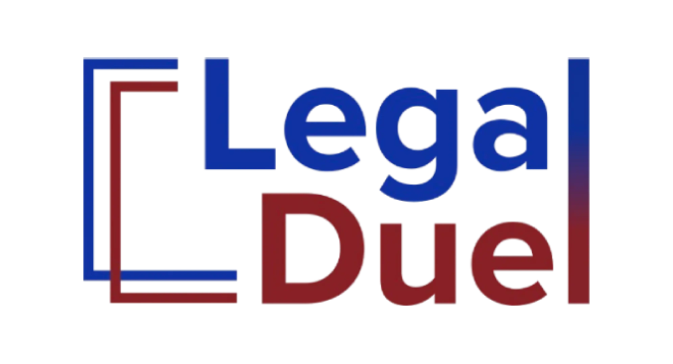
What is LegalDuel?
Platform where attorneys or in-house legal departments can submit specific legal tasks.
Legal tech providers compete to complete these tasks
Arbiter bots evaluate the submitted results, assessing quality, accuracy, and efficiency.
Best result is selected and sent back to the attorney
Notes:
Yomna: Legal Duel is an online platform where legal professionals can submit specific legal tasks. Within legal duel are tools that several legal tech providers have submitted. An arbiter bot evaluates these tools and selects the model with the best performance for the task requested and sends a result back to the client.

Slide 9
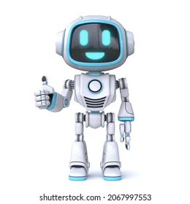
Business Impact
Lower Prices for Legal Fees
With More Time, Competition, and Innovation, Law Firms Can Help Clients More Efficiently for Less Money
More Competition
Permeating AI Models into the Market
More Innovation
New, Unique Solutions Arise from use of New Technology and Competition
More Time for Legal Professionals
Lawyers Spend Less Time Doing Tedious Tasks from these Innovations
Notes:
Tiffany slides 11-14 The business impact of this product and project are shown here in the cyclical diagram. Legal Duel and its services encourage more competition to be added in the market with competing AI models. In turn, resulting in more innovation from this increased competition. Which then results in more time for legal professionals to spend on other tasks while an AI model is doing a lower-level, more tedious task. Which ultimately can reduce legal fees. Resulting in what we all want, a more equitable justice system

Slide 10
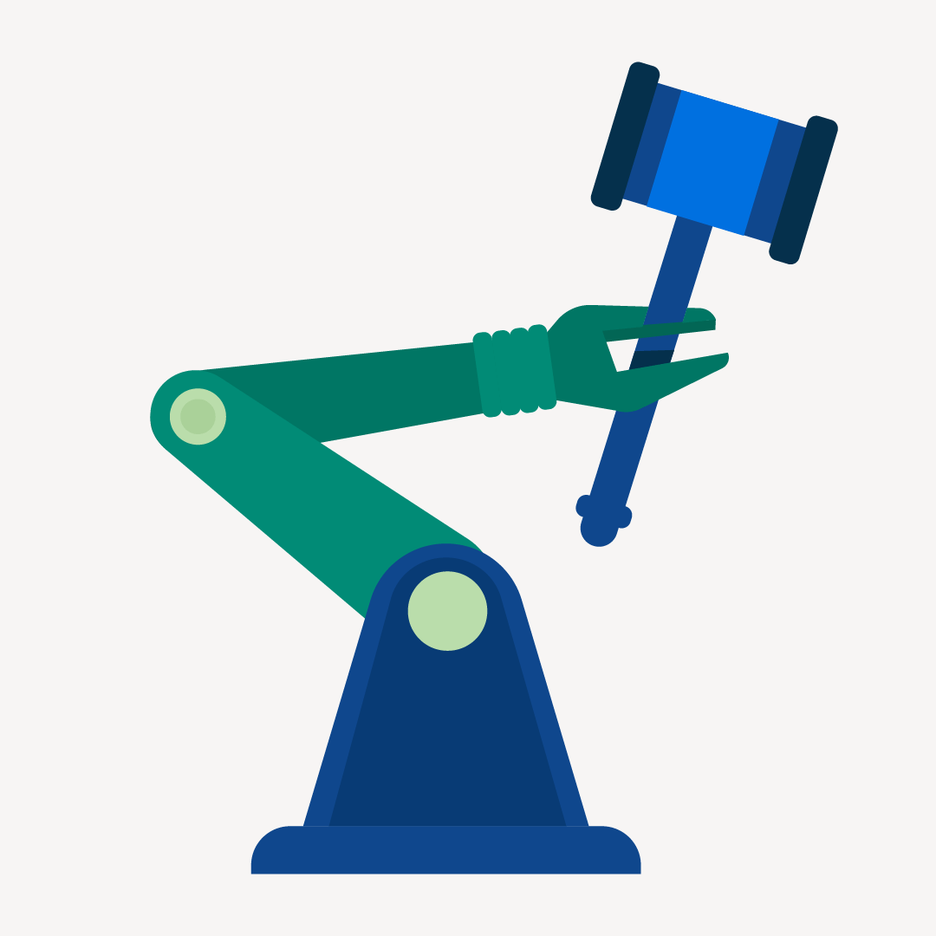
Our Goal
Create a Chronology
Detect Sentiment
Redact Documents
Notes:
Yomna: The advisors were flexible with the tasks given to us. We were allowed to complete all three projects, or 1 or 2 of them really well. We decided to tackle creating a chronology task.
AI-Hub-What-is-AI-and-How-Can-Lawyers-Use-It.png

Slide 11
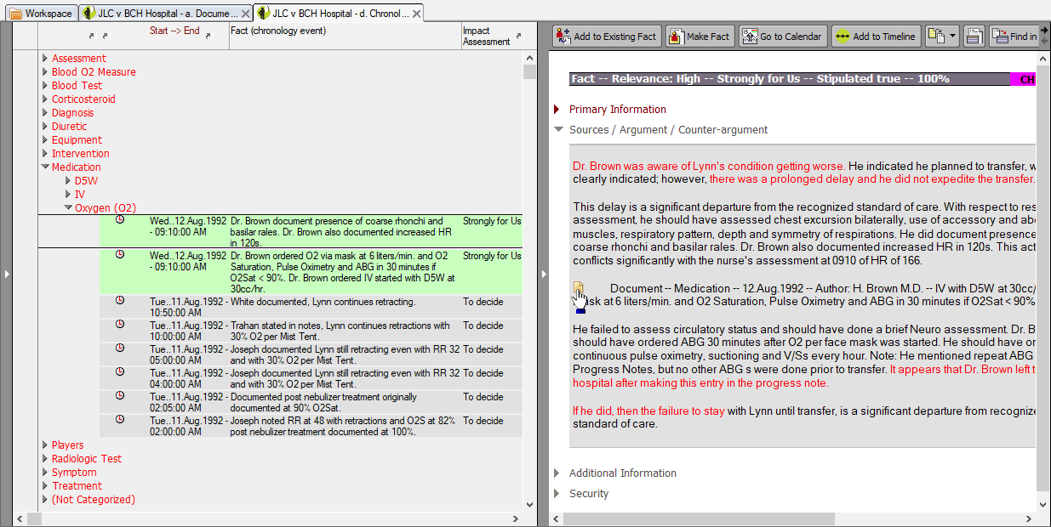
What is a Chronology?
At first, we did not know what a chronology was
Document outlining a timeline of events regarding a case
Typically compiled by an attorney sifting through vast amounts of interviews, emails, and other documents to build a timeline
← Example Chronology
Notes:
Yomna: A chronology: A document that outlines a timeline of events regarding a case. It is compiled by an attorney sifting through vast amounts of interviews, emails, and other documents to build a timeline, making it a great task where AI can step in

Slide 12
Our Approach
1
2
3
4
5
Research
Data Preparation
Modeling
Testing
Implementation
What is a chronology?
Gathering data provided and formatting it.
Fine tuning and using a large language model that best fits our project.
Running through test cases to assess performance.
Developing a web application for client use.
Notes:
Tiffany: We began by looking up legal terms like what a chronology is. Then in the data preparation stage, we decided to read and analyze the given data files and try to format it in the best way using Python libraries. Then in the modeling stage, we fine tuned an LLM to create our chronology. During the testing phase, we tested which hyperparameters and models had the lowest test loss. And when we started implementing the project, we decided to create a web app that incorporates AI into creating chronologies.

Slide 13




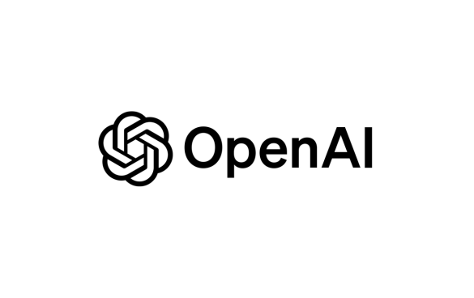

Resources We Leveraged
Notes:
Tiffany: Here are some resources we used throughout the course of the project. (Pictured top left to bottom right): Open AI, spaCy, Google Colab, GitHub, Visual Studio Code, and Python.

Slide 14
Summary of Insights & Key Findings
Model | Average Placement (Lower = Better)
LegalDuel (GPT-4o) (Bot 5) | 8.869565
LegalDuel (GPT-4o) (Bot 4) | 8.73913
Break Through Tech - Team 1B | 8.130435
AI21 (Jamba) | 7
LegalDuel (GPT-4o) (Bot 2) | 6.869565
LegalDuel (GPT-4o) (Bot 3) | 6.391304
Mistral | 6.304348
LegalDuel (GPT-4o) (Bot 1) | 6.217391
Cohere (Command) | 5.869565
Google (Gemini) | 5.73913
OpenAI (GPT) | 5.434783
Anthropic (Claude) | 5.045455
Microsoft (Phi) | 4.625
Leveraged OpenAI’s API to create an AI Agent
Built a platform for visualization and ease of use
Best model training loss = 0.0027
Placed 11th out of 13 bots on LegalDuel
Notes:
Tiffany: Before going into specifics, here are some of the general results. When we submitted our product, an AI agent along with a visualisation tool, this is how it performed. The best model training loss was 0.0027 (a 99% decrease of training loss from our first model). And it placed 11th out of 13 bots on LegalDuel. However, some of the newer models we implemented later in this presentation we will note we did not have time to test on LegalDuel’s platform.

Slide 15
Data Understanding & Data Preparation
Notes:
Zoe 15-19

Slide 16
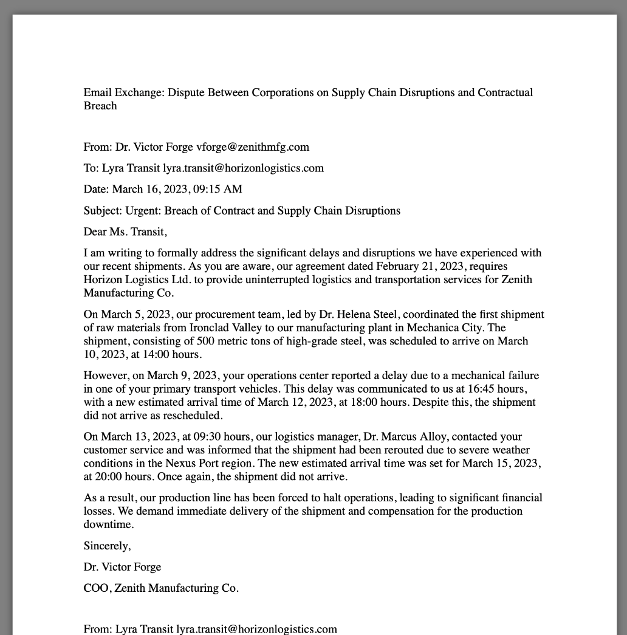
Dataset Overview
Given 30 instances of mock interviews, emails, and other documents
Not real case scenarios
Docx format
701 KB of data
Example of part of an email chain used →
Notes:
We were given 30 mock interviews, emails, and other documents (not real life, in docx format, 701KB).

Slide 17
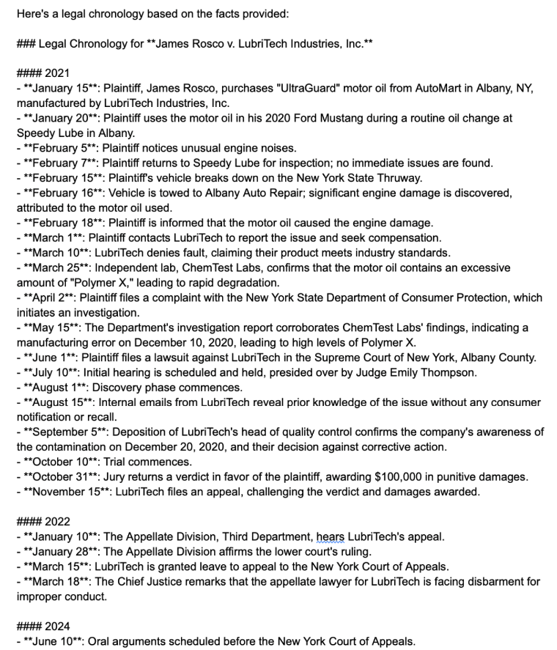
Exploratory Data Analysis (EDA)
Read sample documents
Made chronologies by hand
Compared against popular online AIs (Chat GPT, Claude)
Performed fairly well against our handmade ones
Our chronologies and the AI ones generated errors at a similar rate
Example of one of ChatGPTs outputs
Notes:
We read the docs, hand made chronologies and compared our results with the AI models. AI models performed well with handmade ones.

Slide 18
Data Cleaning and Preprocessing
Converting the form of documents from docx to plain text format
Use of ChatGPT in our model let us spend less time on this step
It already has cleaning and preprocessing built into its own model
Experimented with date extraction outside of ChatGPT’s model
None were able to challenge its accuracy
SpaCy
Stanford Core NLP
Duckling
Notes:
For data cleaning and preprocessing, we had to go through a few steps. First we had to convert our documents that were given to us in docx format into plain text through some conversions in Python. However, much of this step was able to be handled quickly as the use of ChatGPT in our model meant that this step was already done sufficiently through Open AI. Outside of this, we tried to experiment with some other tools including spaCy, Stanford Core NLP, and Duckling. However, none of these were able to challenge ChatGPT’s data cleaning and preprocessing capabilities.

Slide 19

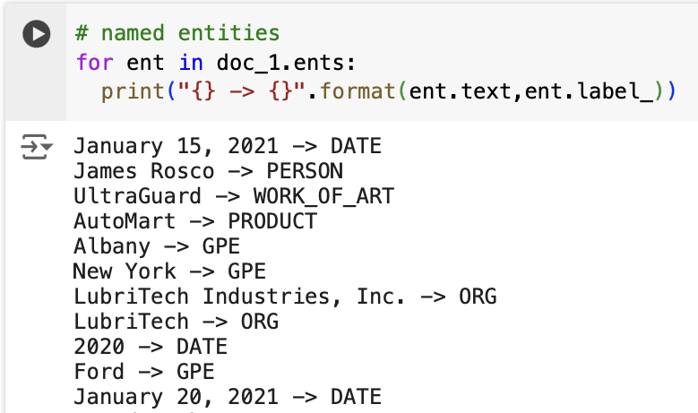
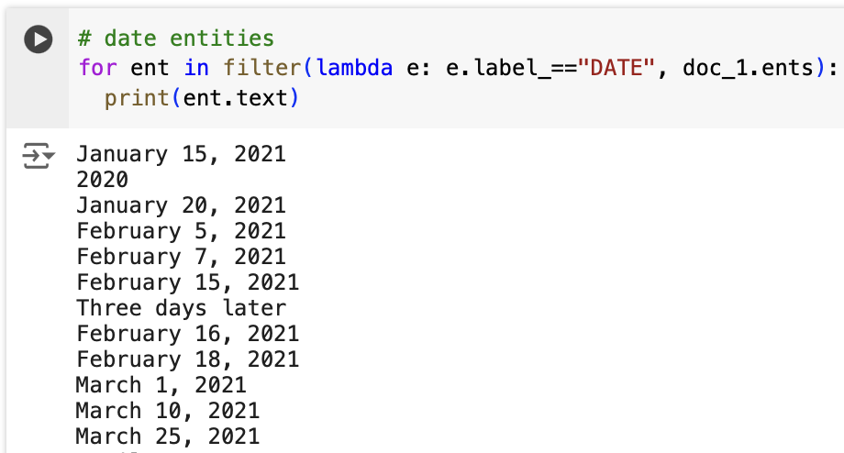
Example
SpaCy Date Extraction Code
Notes:
In the left image, we used spacy to extract entities in the documents (date, Person) In the right image we extracted specific dates (January 15, 2020)

Slide 20
Modeling & Evaluation
Notes:
Tiffany slides 20-22

Slide 21
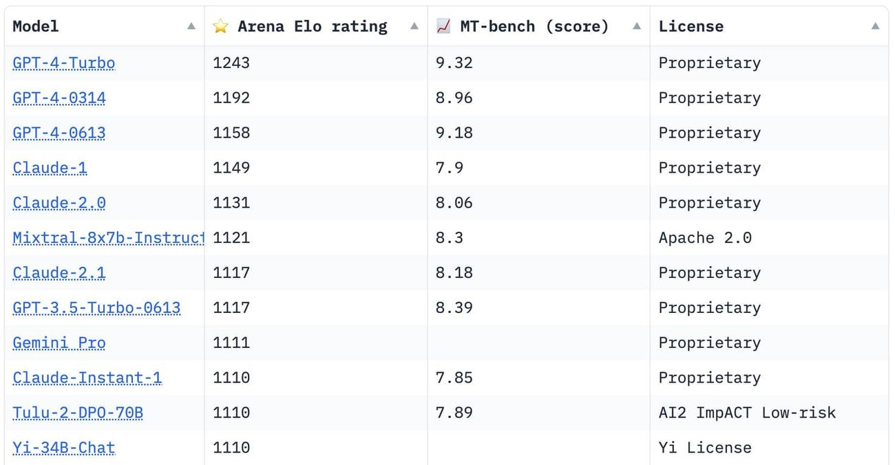

Large Language Models
Notes:
Tiffany: Research into LLMs. Chatbot arena. We used chatgpt’s pretrained models to finetune and use for our web application.

Slide 22
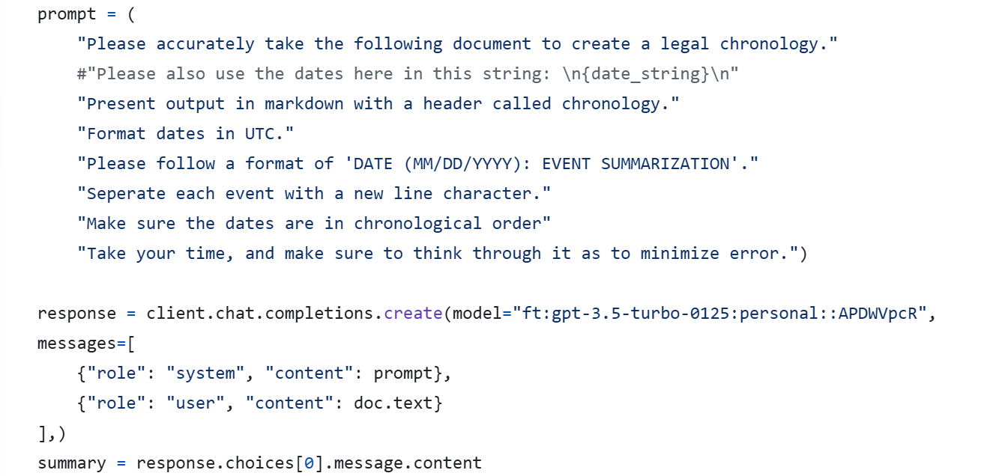
Prompt Engineering
Explored refining the prompts given to ChatGPT
Overall, proved to be unhelpful, especially with more detail given
Issue of model making incorrect assumptions
Example: Treating every case as a drug case
← Final use
Notes:
Tiffany: We decided to use prompt engineering so our model can give the best response. The prompt tells the model how it should format and create a chronology and the model will return a descriptive summary of events to create a chronology.

Slide 23
Model Comparison: First JSONl file
Model Name | Description | Results | Pros | Cons
gpt-4o-2024-08-06 | Chat GPT 4o 10 Epochs | Training Loss: 0.0027 | Low Training Loss | High Cost
gpt-3.5-turbo-0125 | Chat GPT 3.5 turbo (default: 3 Epochs) | Training loss: 0.8 | Low Cost | High Training Loss
Notes:
Yomna: After prompt engineering, we started the fintuning step. We created a Json file with 10 training examples. In our first version of testing, here the results are displayed for two models that we used. Chat GPT 4o had a low training loss, yet a high cost when compared to Chat GPT 3.5 turbo.

Slide 24
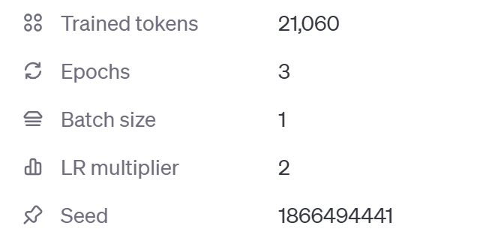
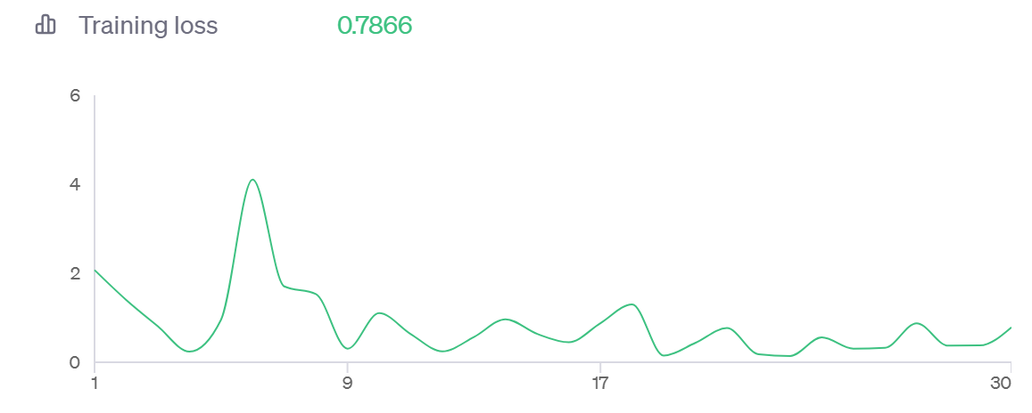
gpt-3.5-turbo-0125: default
Notes:
Yomna: Some specifics of Chat GPT 3.5 turbo’s hyperparameters and results are shown here. As you can see the training loss was relatively high at 0.7866. This indicates there could be underfitting. The hyperparameter we changed throughout the testing was the number of epochs.

Slide 25
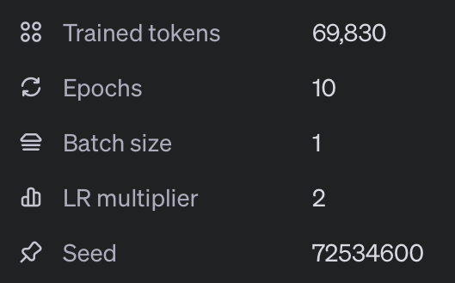
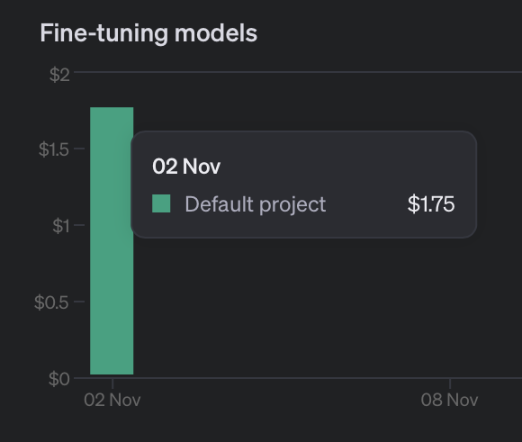
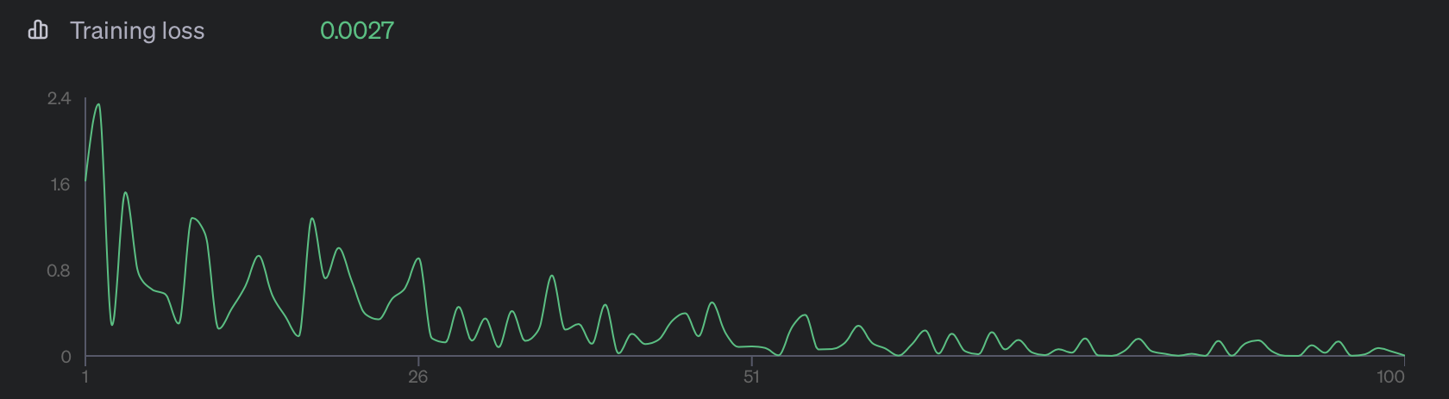
gpt-4o-2024-08-06
Notes:
Yomna: We used default hyperparameters and adjusted the epochs each time. Epochs = 10. Training loss = 0.0027 which is really low, indicating overfitting to the data.

Slide 26
Model Comparison: Second JSON file
Model Name | Description | Results | Pros | Cons
gpt-3.5-turbo-0125 | Chat GPT 3.5 turbo 10 Epochs | Training loss: 0.0163 | Low Cost Low Training Loss | Slightly higher cost than with default values
gpt-3.5-turbo-0125 | Chat GPT 3.5 turbo 5 Epochs | Training loss: 0.2 | Low Cost Low Training Loss | Higher training loss than gpt-3.5-turbo-0125
Notes:
Yomna: We then went through a second round of testing with more refined data in our JSONI file. Results from this are shown here and are relatively similar to the first round. We did not test Chat GPT 4o in this round due to a high cost of testing. However, we were able to get Chat GPT 3.5 turbo to give lower training losses than before.

Slide 27
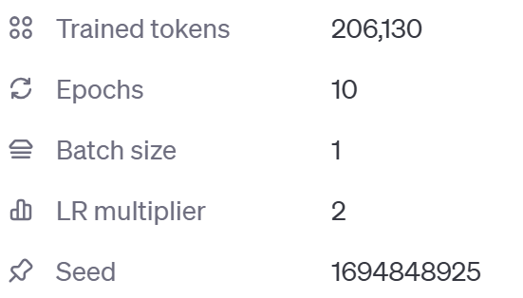
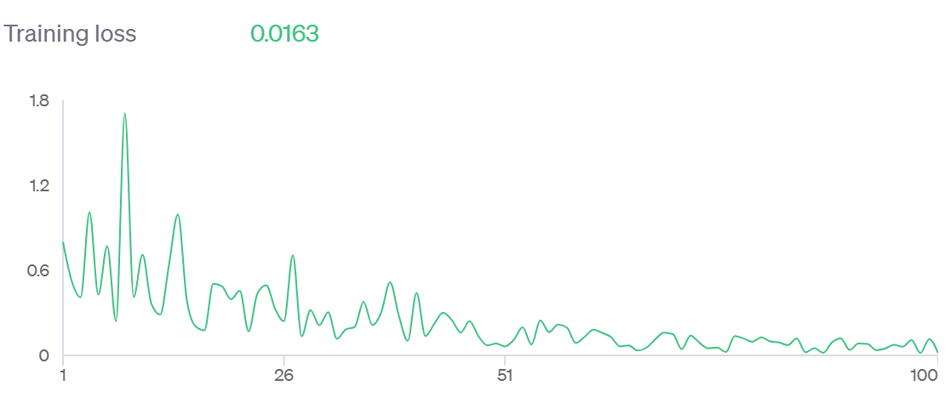
gpt-3.5-turbo-0125: 10 epochs
Notes:
Yomna: Epochs = 10, Training loss = 0.0163, not as low as gpt 4 but still overfits the data.

Slide 28
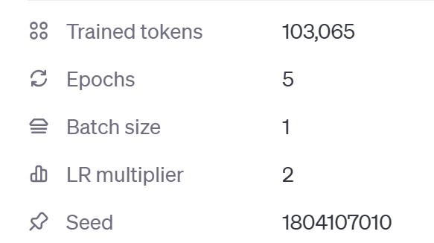
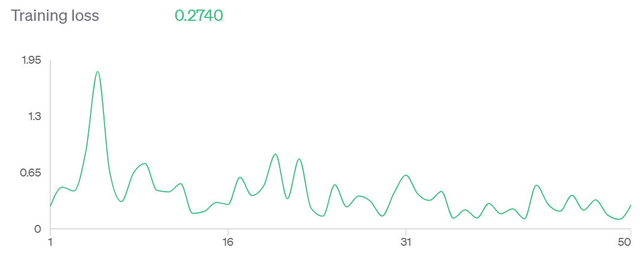
gpt-3.5-turbo-0125: 5 epochs
Notes:
Yomna: 5 epochs. Training loss = 0.2740, low training loss, but not to the point where it is overfitting the data.

Slide 29
Insights and Key Findings
gpt-4o-2024-08-06 = low training loss, but high cost
gpt-3.5-turbo-0125 (5 epochs) = low training loss and cost, without over or underfitting
Notes:
Zoe slides 29-34 In the first round of testing we saw that Chat GPT 4o had a very low training loss, but a high cost. It also could be overfitting data with a loss that low. In the second round the best model for us was GPT 3.5 turbo with a hyperparameter of 5 epochs. This was decided from looking at tradeoffs in performance and cost.

Slide 30
Implementation
Users can type in text or upload a pdf of a chronology
Once button “generate chronology” is clicked:
Physical text chronology is created
Download a visual timeline of the chronology.
Notes:
Speak on the implementation of the web application

Slide 31
Final Thoughts

Slide 32
What We Learned
How to effectively Prompt Engineer
How different hyperparameters affect the cost
New legal terms :)
Notes:
Read from slides

Slide 33
Potential Next Steps
Continue to Finetune to find optimal hyperparameters
Continue to find the best prompt for prompt engineering
Add a validation set
Try out different LLM models
Notes:
Read from slides

Slide 34
Demo!!!
:)
Notes:
https://www.loom.com/share/916d9db72018424494b9510e509608ff?sid=46336f92-be48-4b1b-870b-63b0c2abb7ed

Slide 35
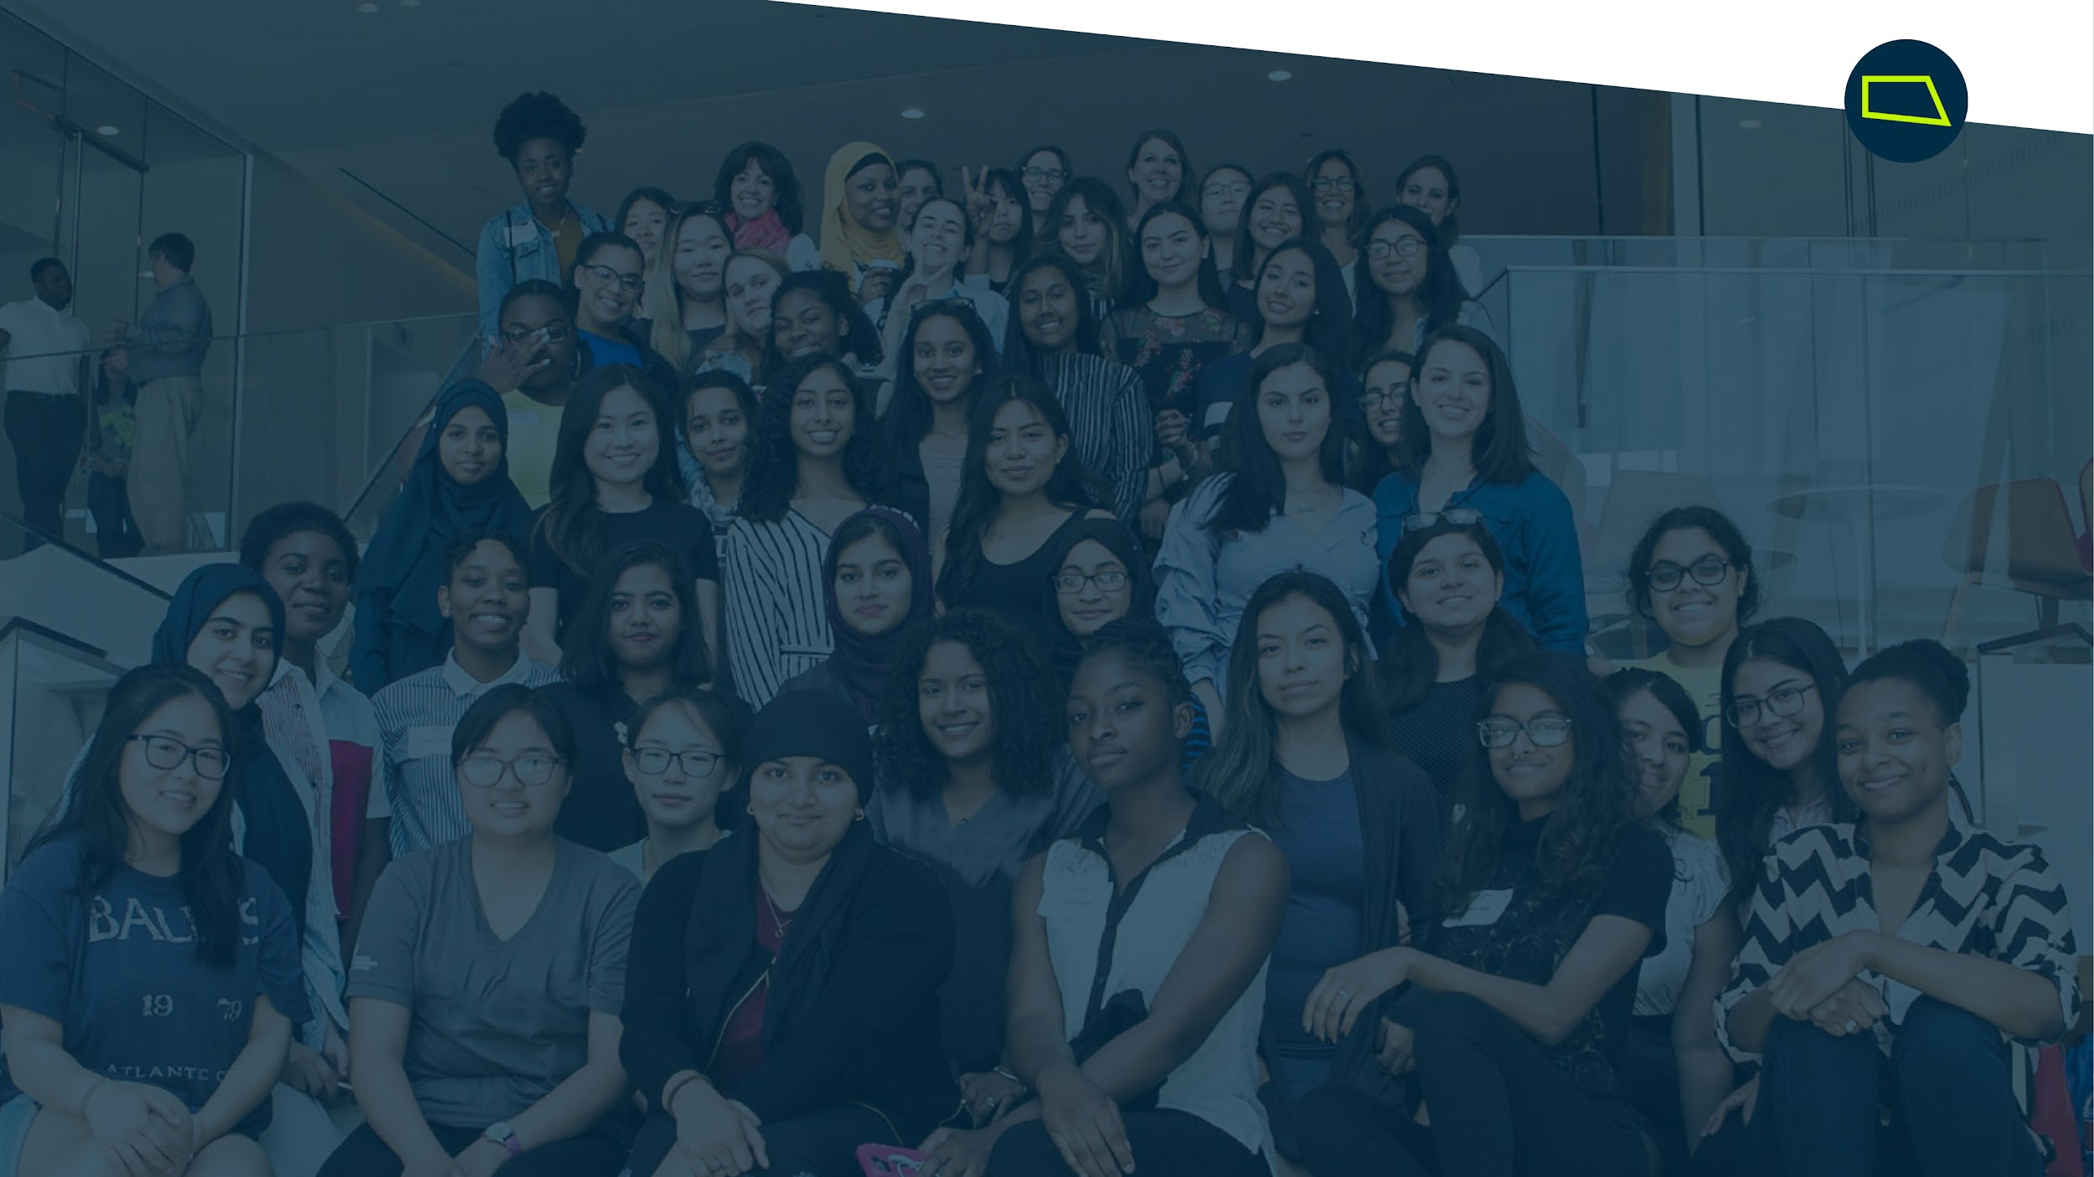
Questions?

